Slide 1

March 2-3, 2027
Our Lady’s Immaculate Heart Church, Ankeny
MidwestOnMission.com

Slide 2
This conference is one more step in our ongoing journey of growing disciples.

Slide 3
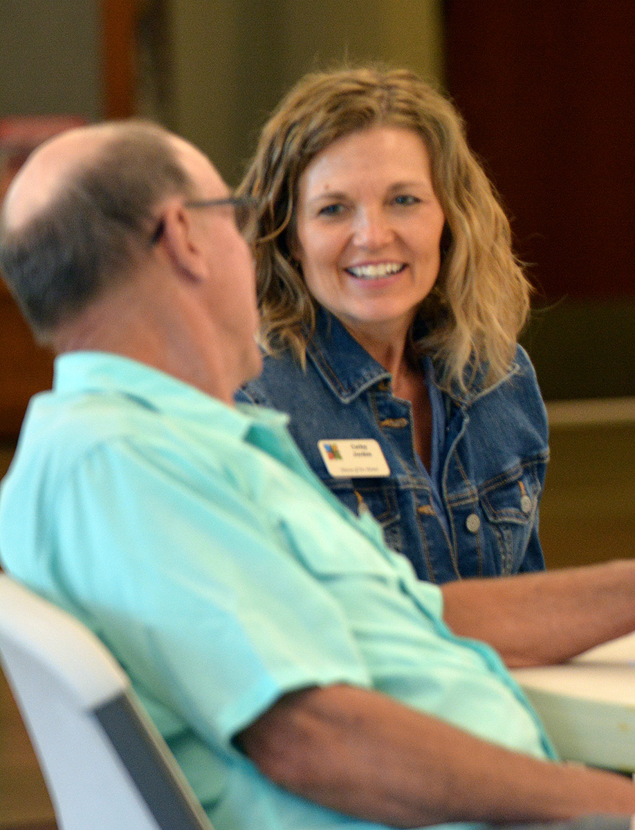
How did we get here?
Mission/Vision
We engaged in an extensive listening process. The result? Our path forward: We are sowing God’s Spirit by cultivating connections in Christ through encounter, friendship, and communion.
Notes:
TBD on what photo would be good here

Slide 4
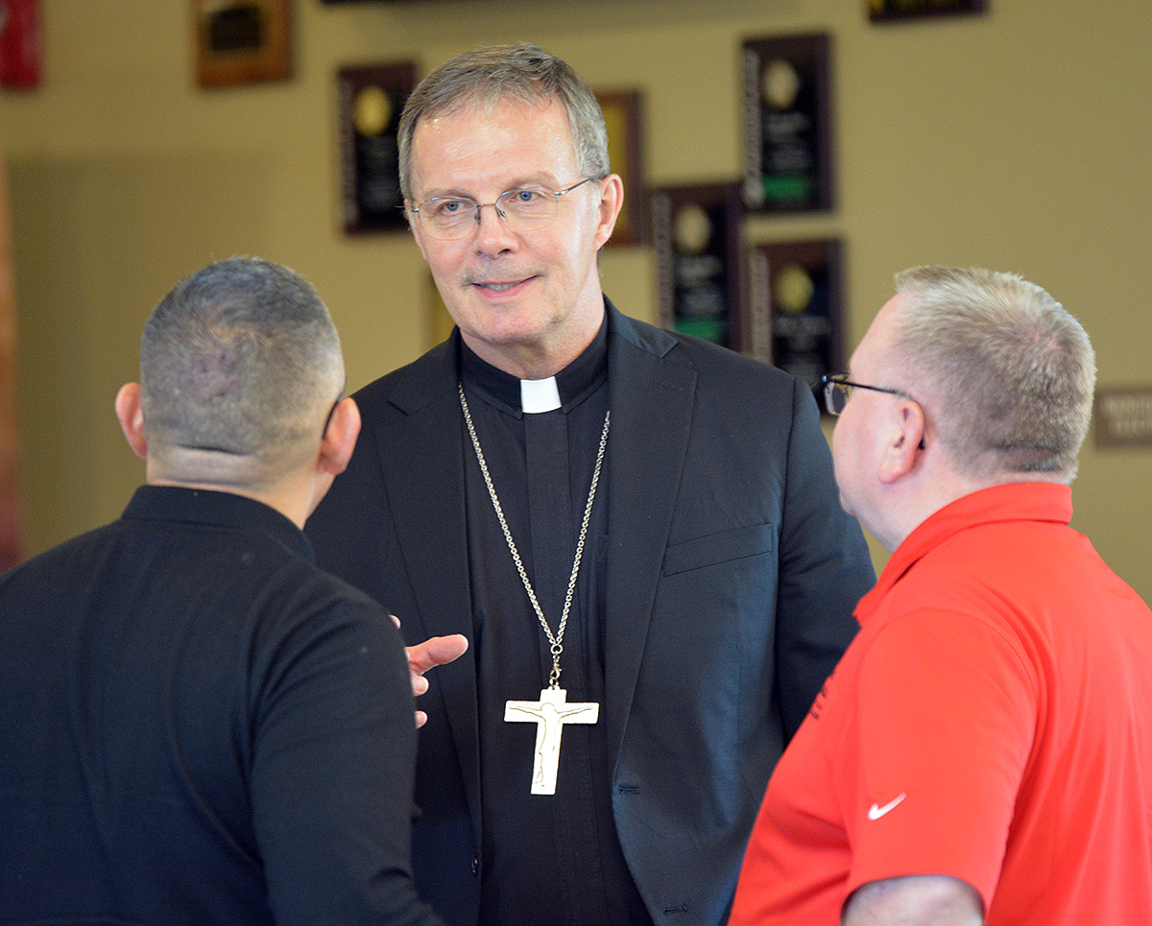
Pastoral priorities
Through that grassroots, synodal process, both leadership and parishioners identified six areas for pastoral improvements on local and diocesan levels.
Toolkits were provided to all parishes that share best practices for effective ministries in these pastoral priority areas.
Notes:
Example of a quick “overview” for each organization to highlight who they are and what they do

Slide 5
What’s next?

Slide 6
From maintenance to mission
Parish renewal means we’re looking at what we do as maintenance (“because we’ve always done it that way”) and moving to an emphasis on mission through active evangelization.

Slide 7
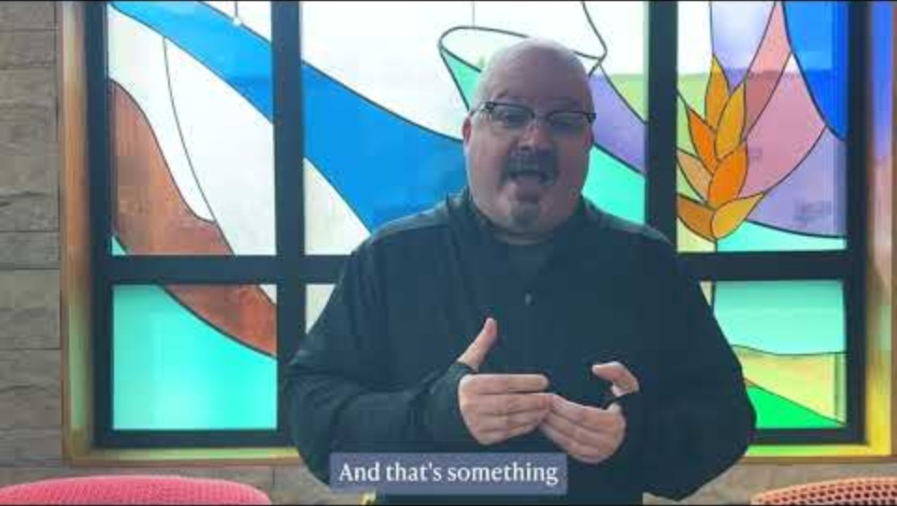
WHAT IS PARISH RENEWAL?

Slide 8
 | Midwest on Mission will be a transformative experience intended to:
 | Inspire priests and parish leaders not currently engaged in missional renewal.
 | Encourage and equip priests and parish leaders already involved in renewal to expand and strengthen their efforts.
 | Share the good news of renewal already underway.
 | Serve as a catalyst in our Diocese, in Iowa, and in the Midwest, resulting in more parishes engaging with mission by clarifying their vision, using effective evangelization tools (like Alpha), and raising up rapier initiatives for mission.

Slide 9
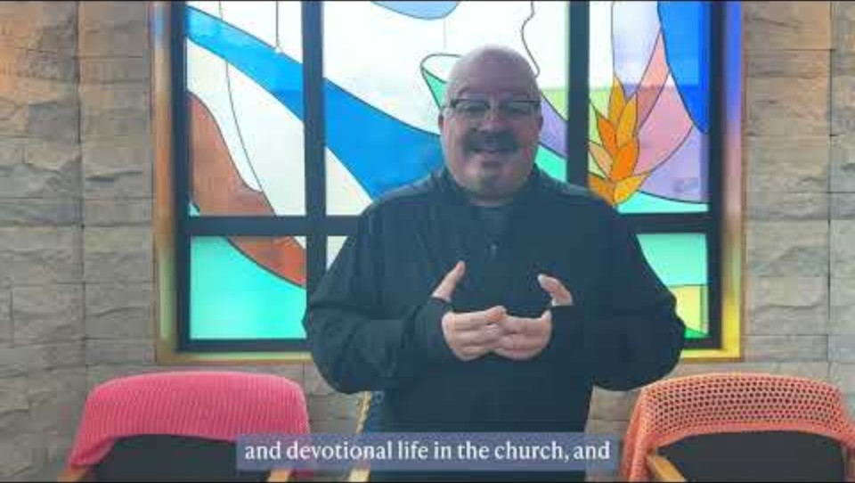
WHY COME TO MIDWEST ON MISSION?

Slide 10
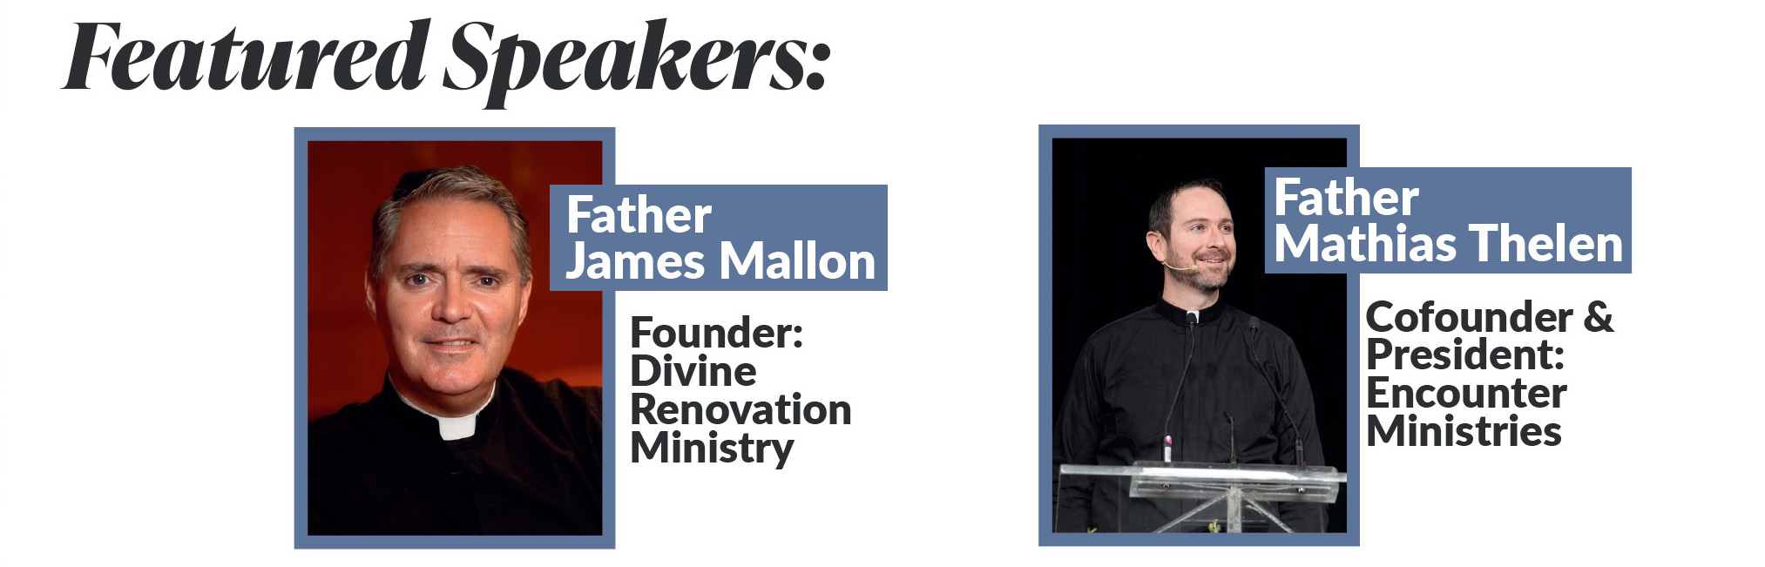

Slide 11
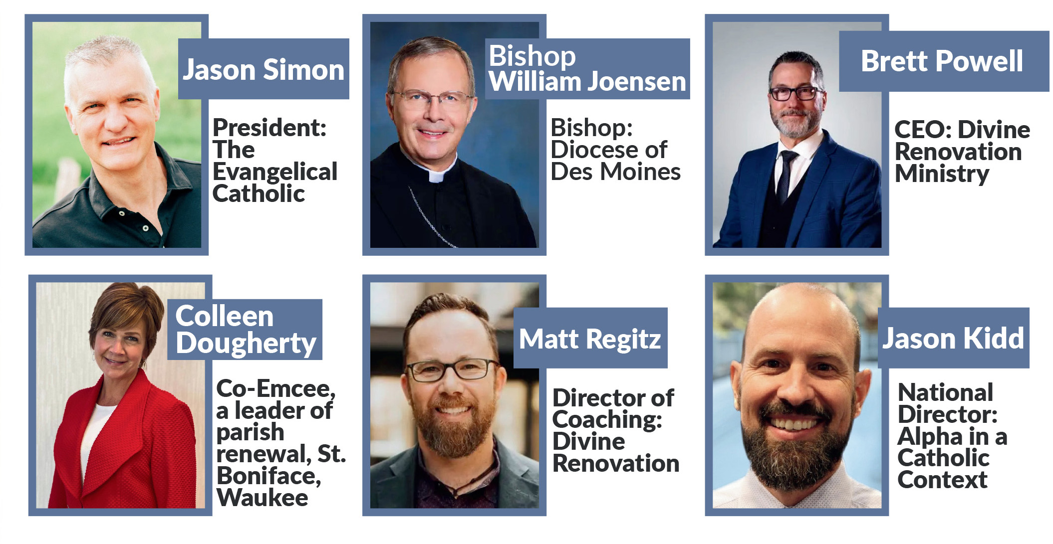

Slide 12
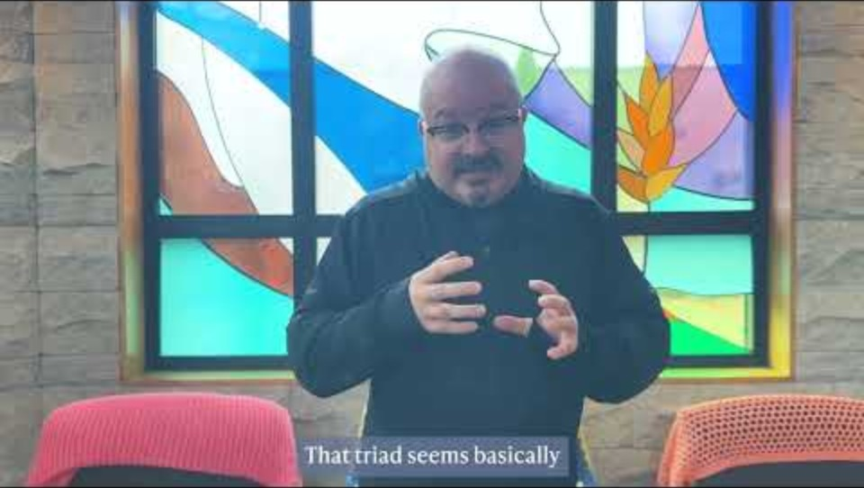
We’ve seen success. Join us as we grow!
Learn how renewal has worked in similar Midwest parishes.
Connect with supportive organizations that show us the path forward and tools that align our missional efforts with our focus of growing disciples.
Notes:
Example of a quick “overview” for each organization to highlight who they are and what they do

Slide 13




Our Partners:
Notes:
Example of a quick “overview” for each organization to highlight who they are and what they do

Slide 14
Tickets on sale: Midwestonmission.com
15% discount for 3+ tickets; 20% discount for 7+ tickets

